Slide 1
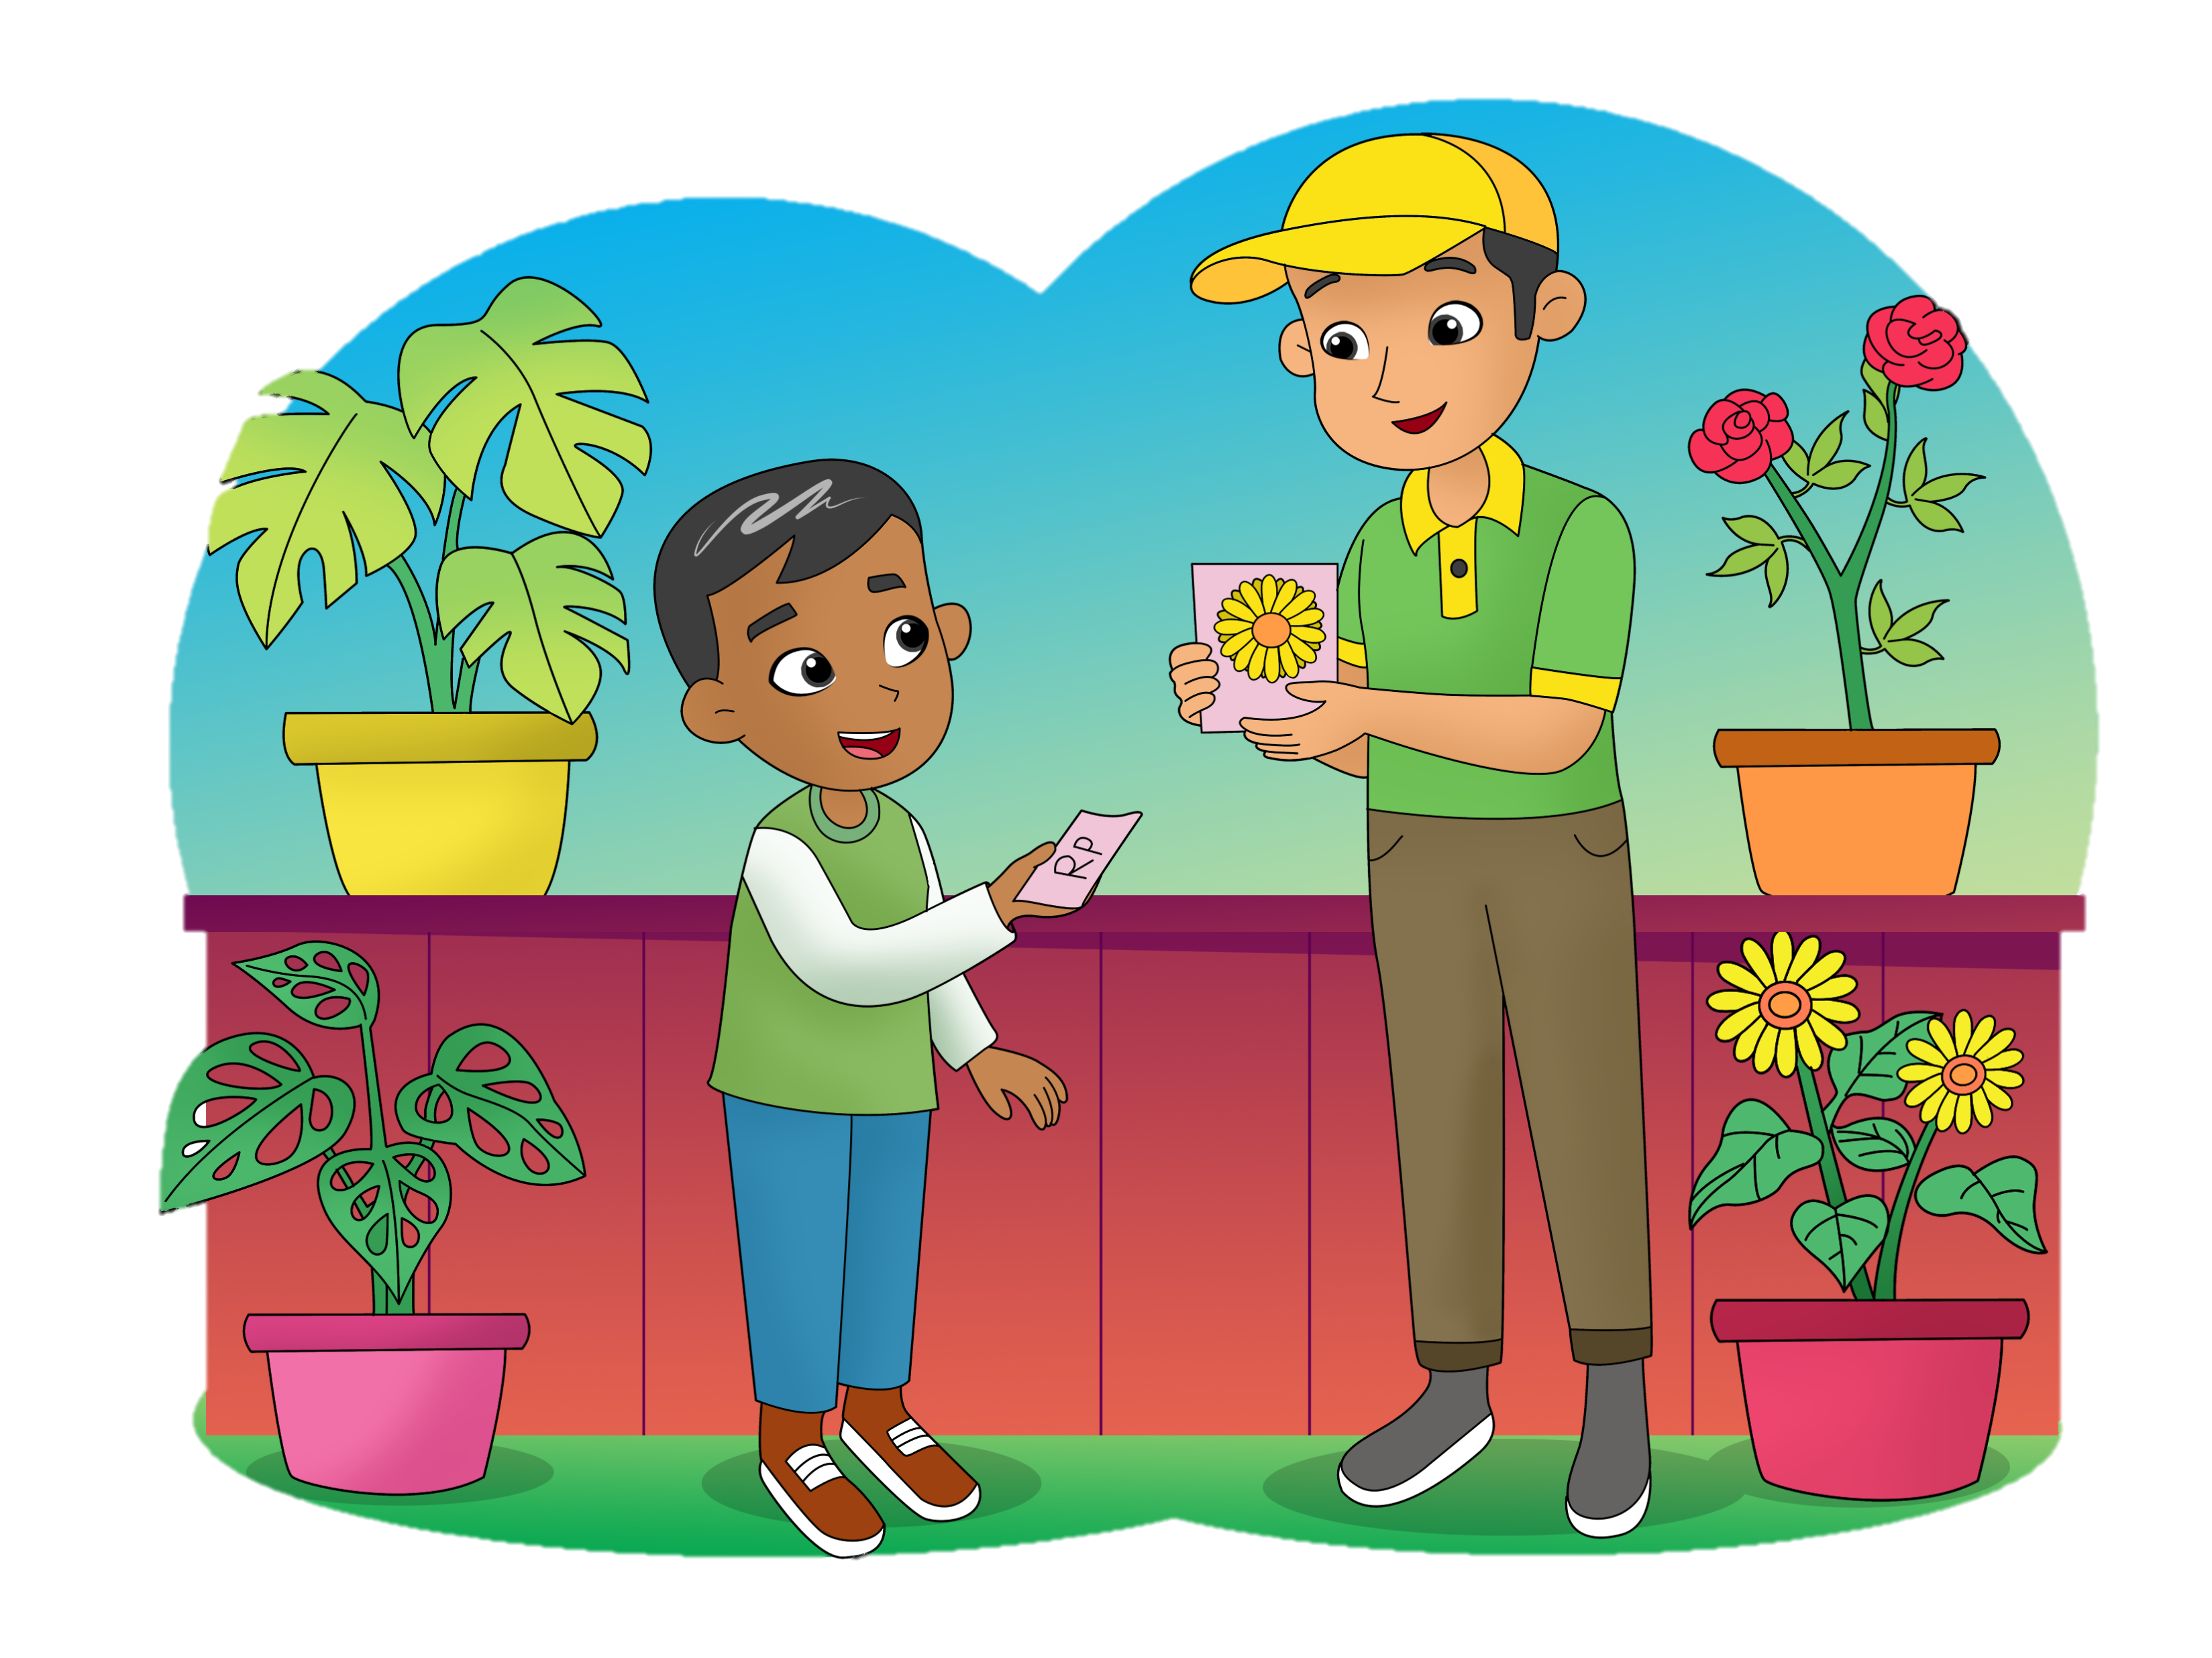
I Want Some Sunflower Seeds, Please
4.
Describe a garden
Ask for something
Follow a procedure
Theme: In the Garden

Slide 2
B.
Read aloud.
leaves
a sunflower
a broom
a trowel
seeds
a watering can
soil
a pot

Slide 3
F.
Listen and do.
Put the soil into the pot.
Make a hole with a finger.

Slide 4
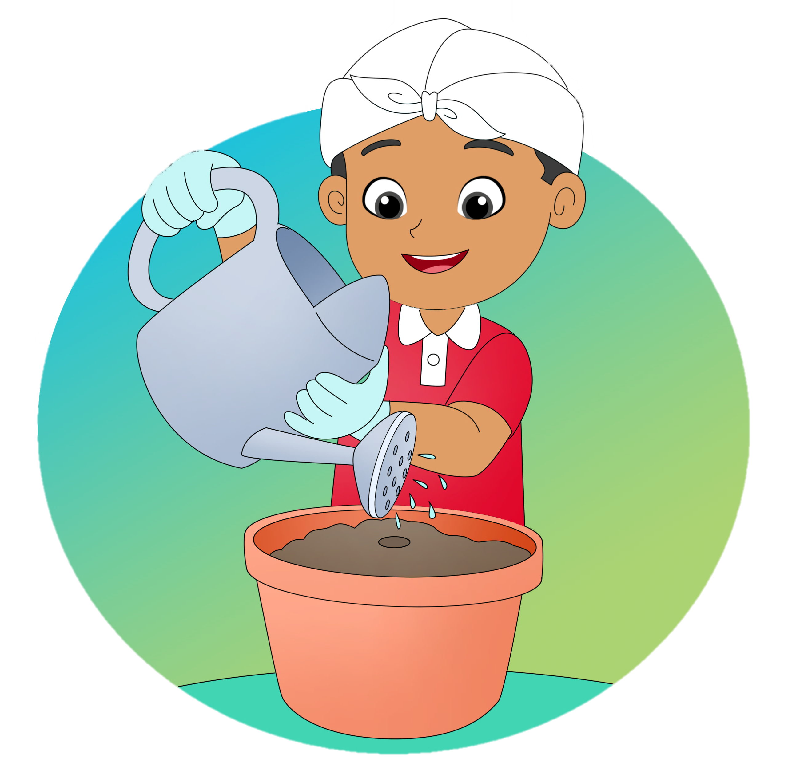
F.
Listen and do.
Put the seeds in the hole.
Water the seeds.

Slide 5
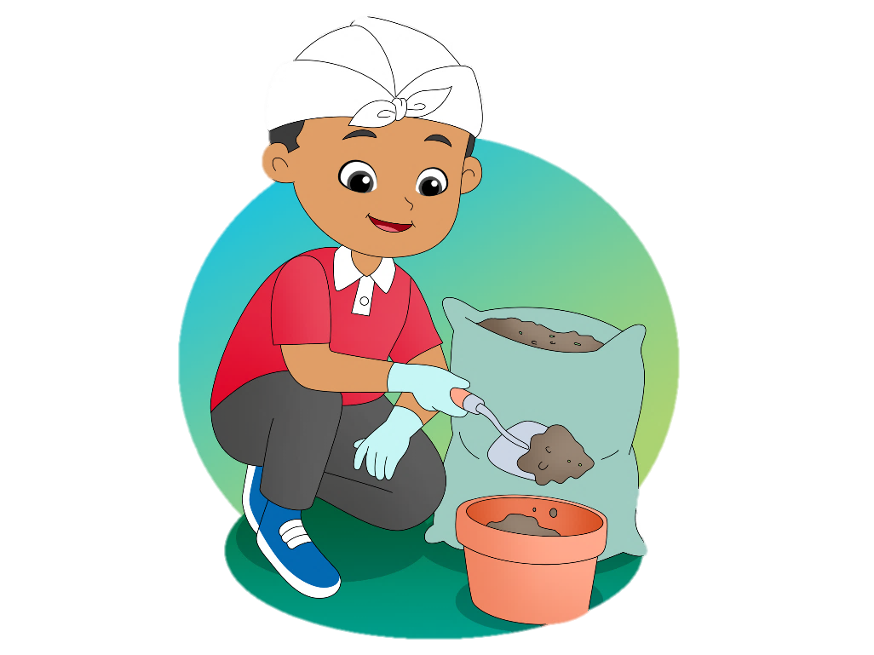
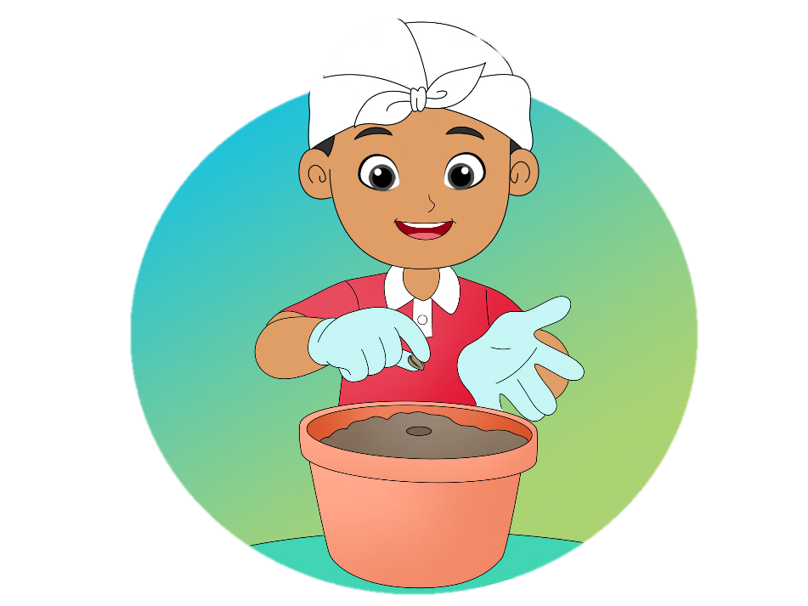
G.
View and sing.
This Is the Way
This is the way we put the soil.
Put the soil, put the soil.
This is the way we put the soil.
Let’s put it in the green pot.
This is the way we put the seeds.
Put the seeds, put the seeds.
This is the way we put the seeds.
Let’s put them in the green pot.

Slide 6
J.
Look and say.
a butterfly
a ladybug

Slide 7
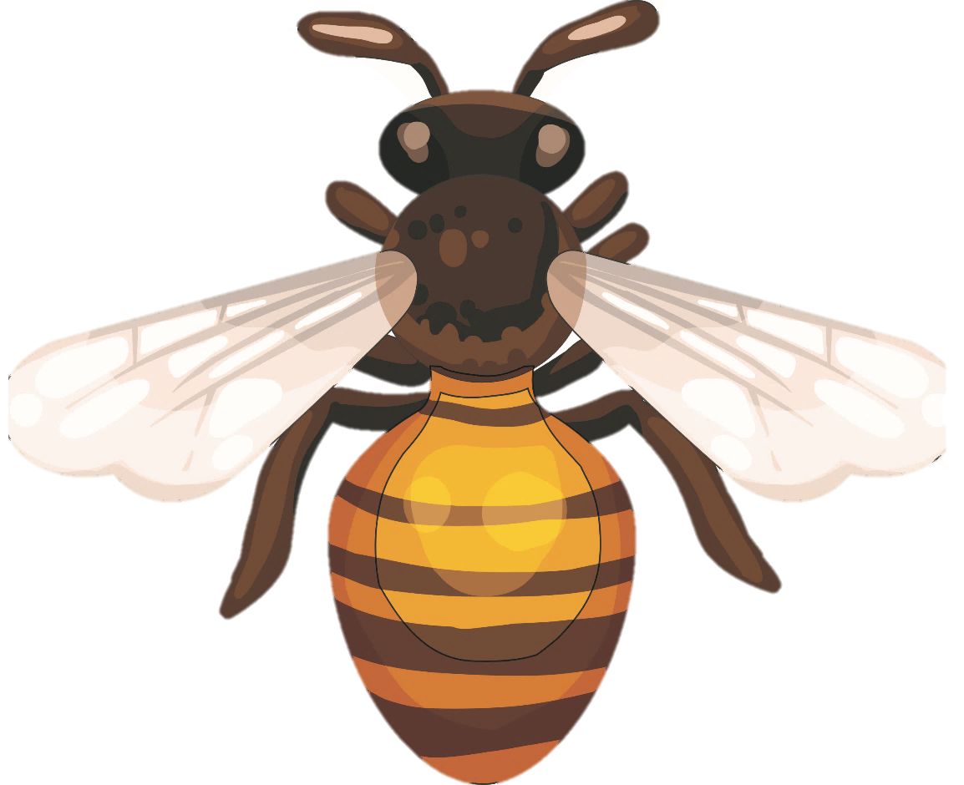
J.
Look and say.
a grasshopper
a bee

Slide 8
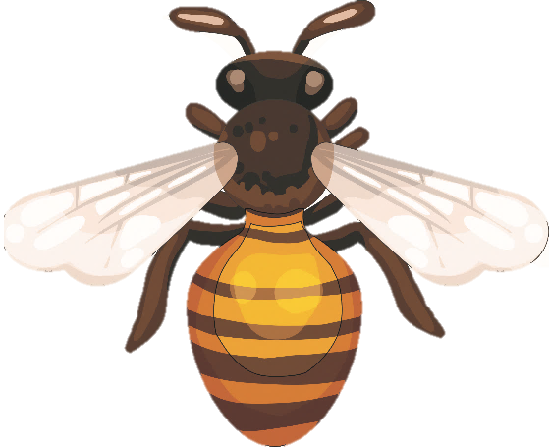
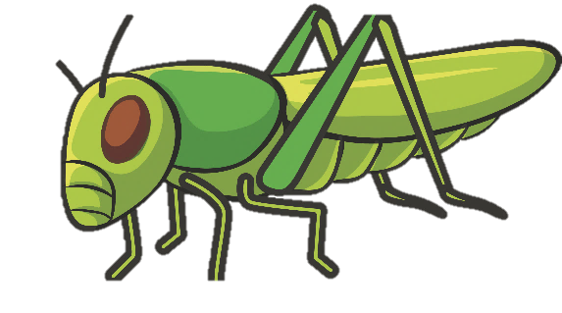
L.
Say a chant.
Insect
Butterfly, ladybug, grasshopper, bee
Where are they? Where are they?
Find them for me
Butterfly, ladybug, grasshopper, bee
Over there! Over there! Under the tree!

Slide 9
N.
Read for fun.
My Grandma’s Garden
This is my grandma’s garden. It is not so big, but it is beautiful. There are a lot of flowers. They are roses, sunflowers, and orchids. The roses are white and red, and the orchids are colorful. In the middle of the garden, there is a big mango tree. There are three chairs under that big mango tree. Next to the tree, there is a swing. I like sitting on the swing.

