Slide 1
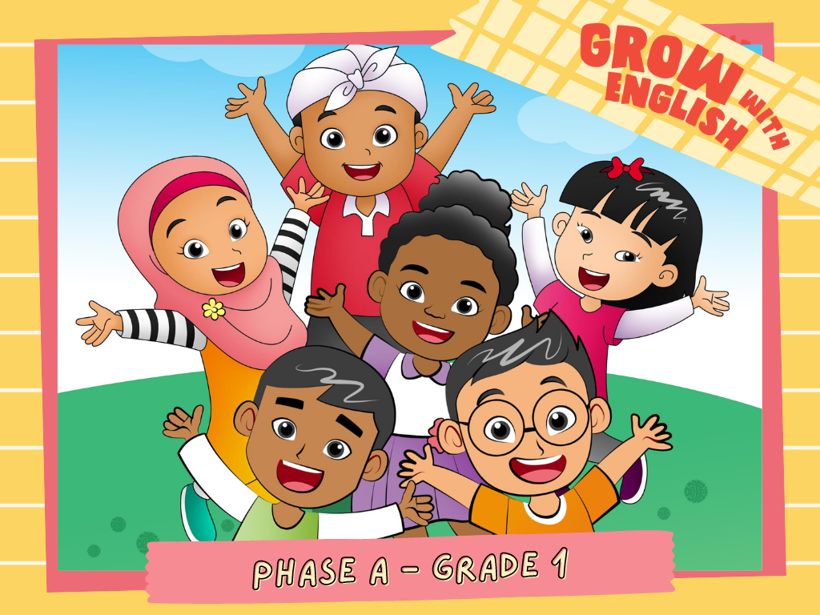

Slide 2
My Toys
Please describe
your toys!

Slide 3
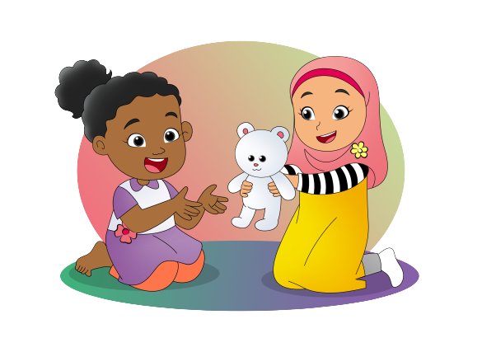
Sure. Here
you are.
May I play
with your doll?
Thank
you.

Slide 4
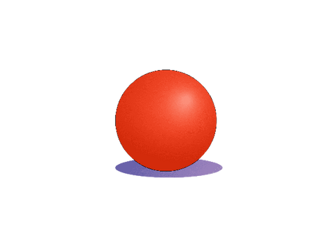
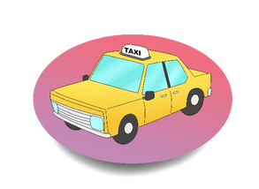
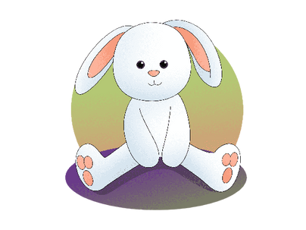
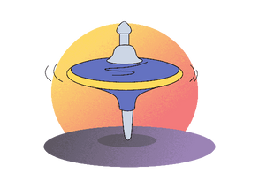
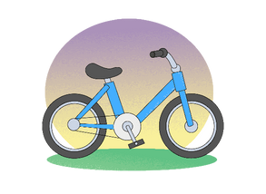
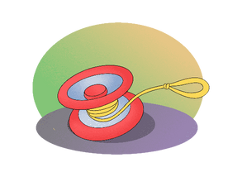

Slide 5
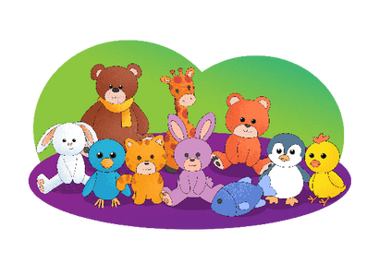
May I Fly Your Pretty Kite?
May I fly your pretty kite?
Pretty kite, pretty kite?
May I fly your pretty kite?
Sure, take your time.
May I play with your cute dolls?
Your cute dolls, your cute dolls?
May I play with your cute dolls?
Sure, here you are.

Slide 6
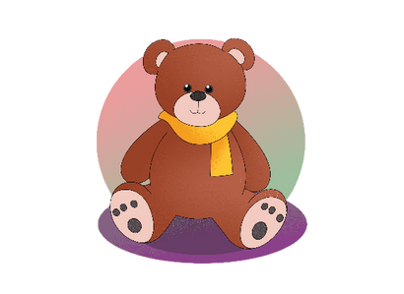
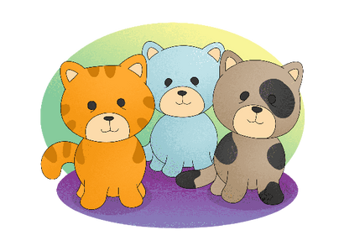
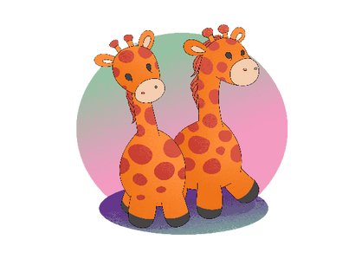
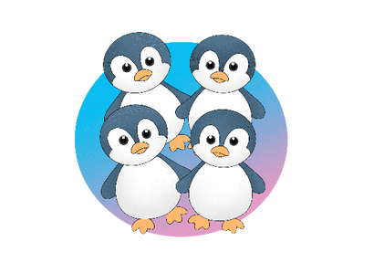
One doll, two dolls, three and four

Slide 7
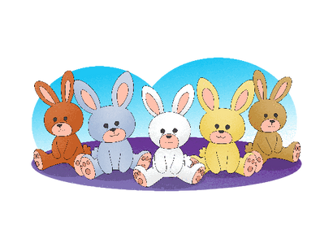
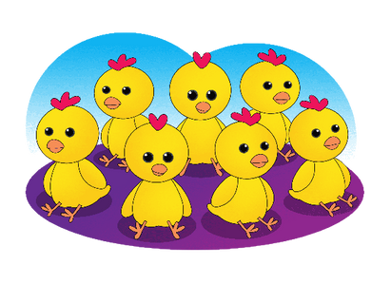
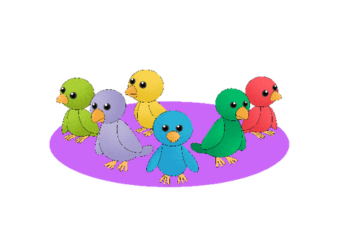
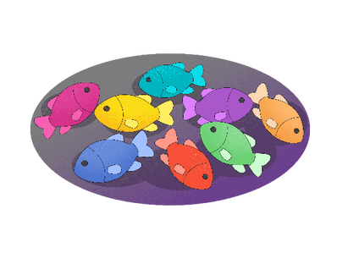
Five dolls, six dolls, seven and eight

Slide 8
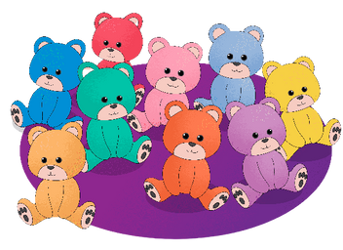
Nine dolls, ten dolls, big and small

Slide 9
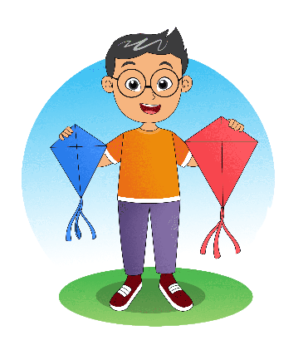
I have two kites.
One is blue and one is red.
My blue kite is small
but my red kite is big.
But they all pretty.
I fly my kites on holidays

