Slide 1
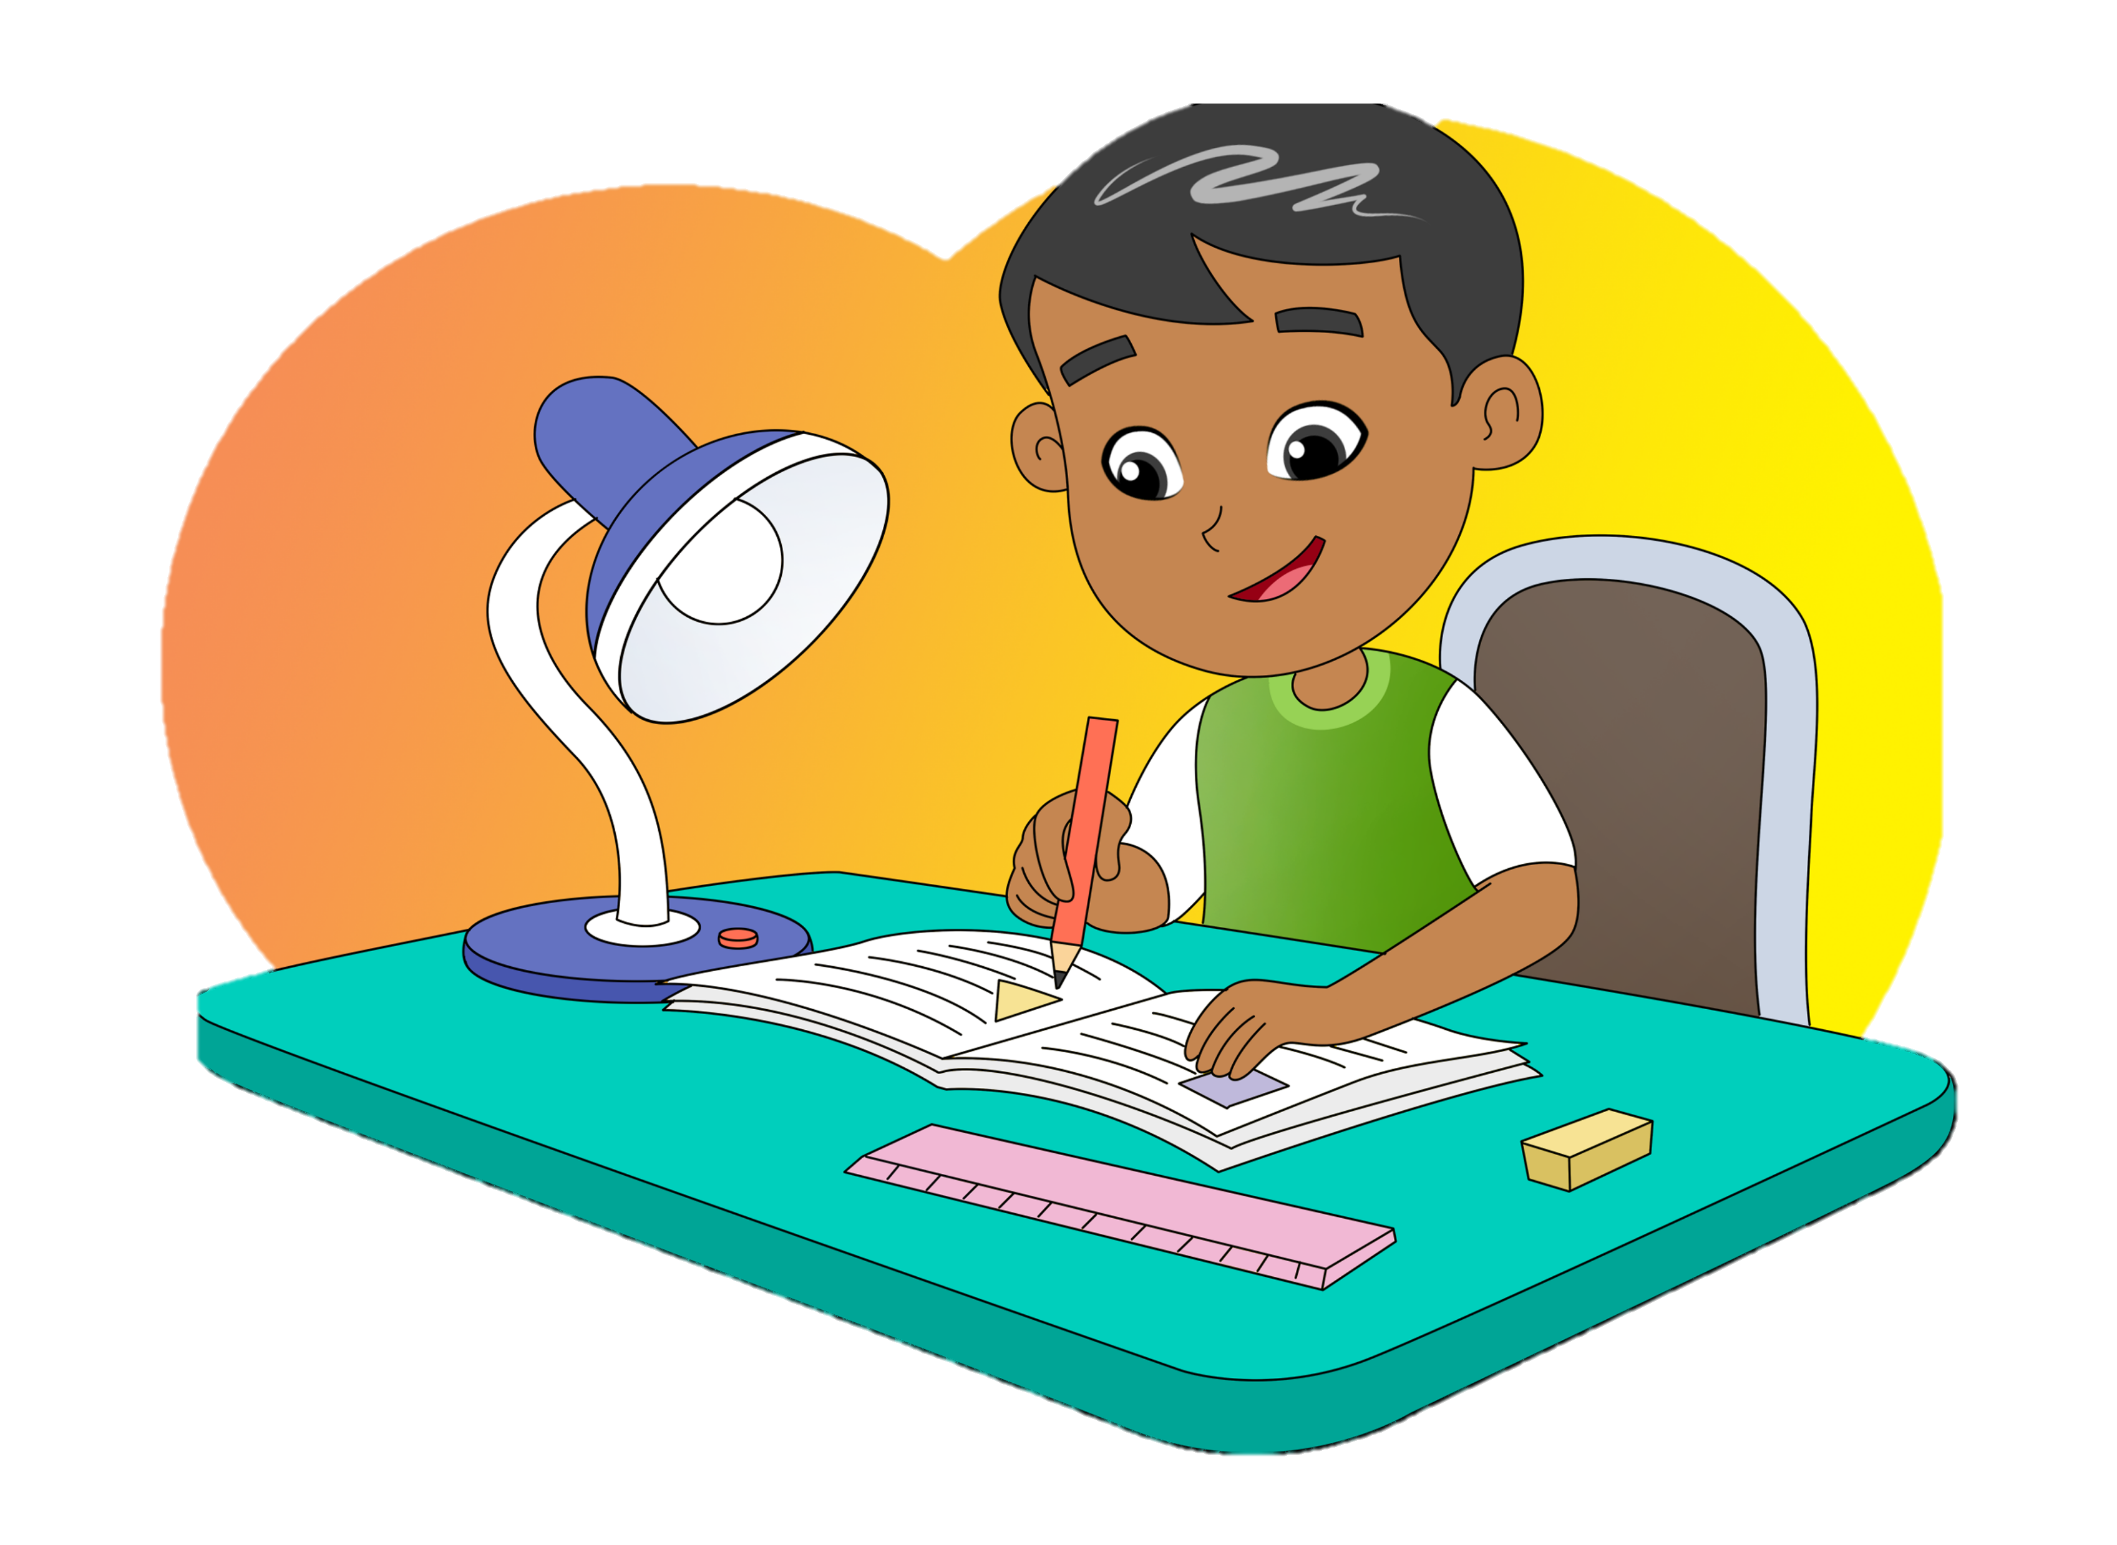
Math Is My
Favorite Subject
2.
Ask and tell about days
Ask and tell about favorite subjects
Theme: Schedule

Slide 2
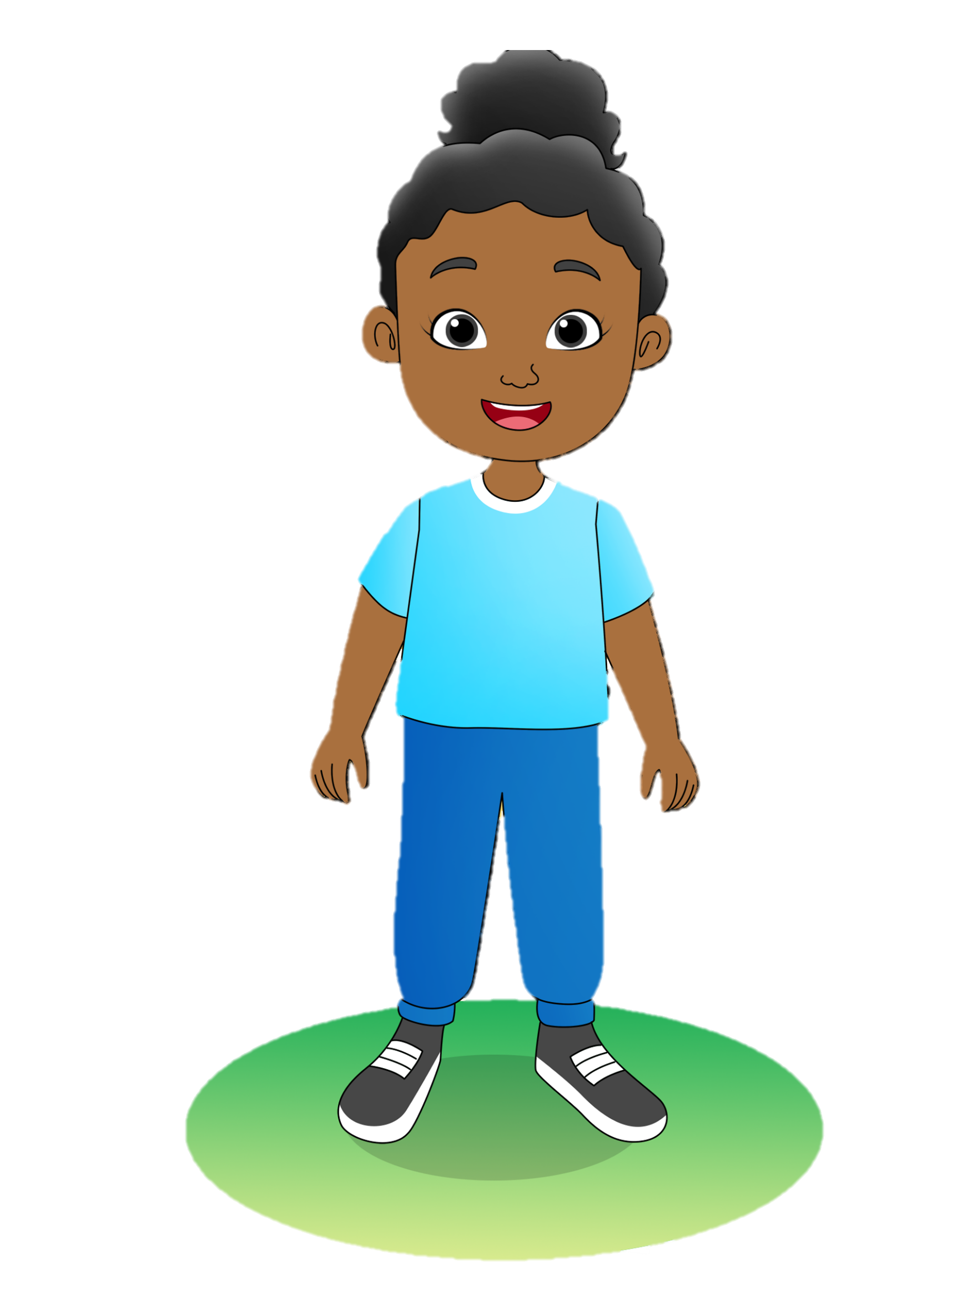
B.
Listen and do.
Stand up.
Swing your arms up.

Slide 3
B.
Listen and do.
Rise up on your toes.
Reach up for the sky.

Slide 4
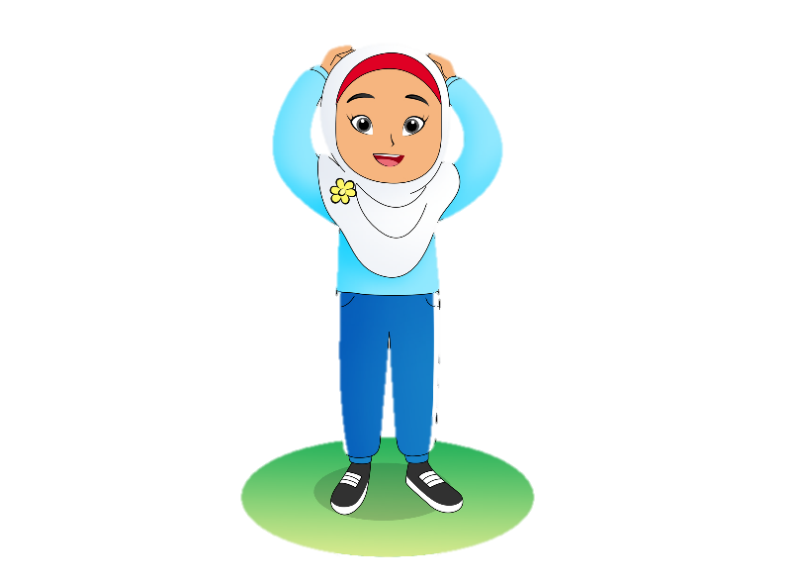
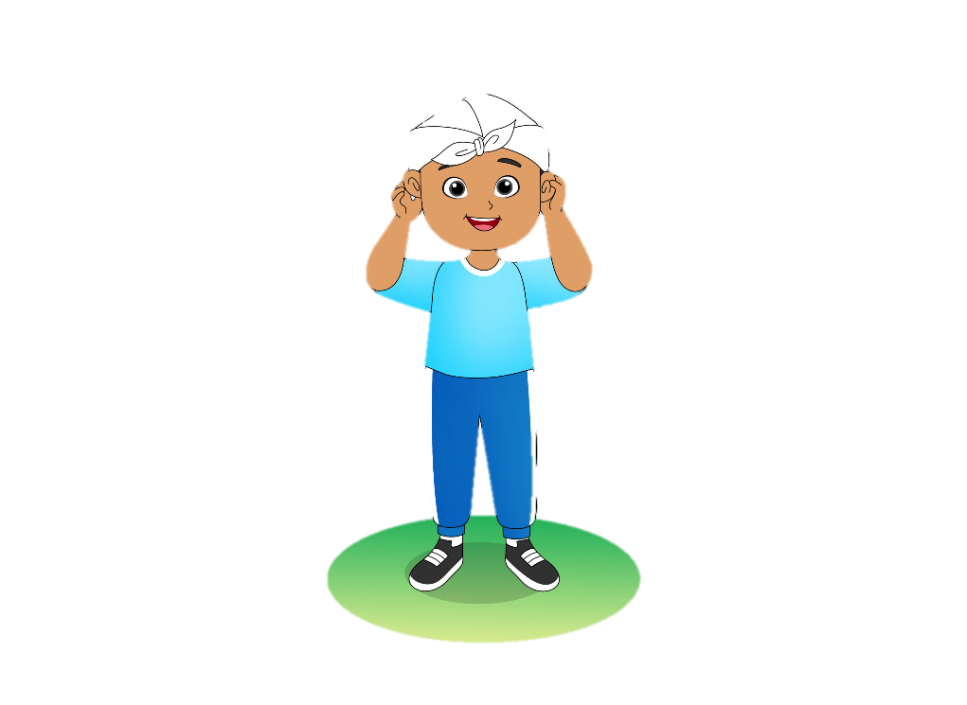
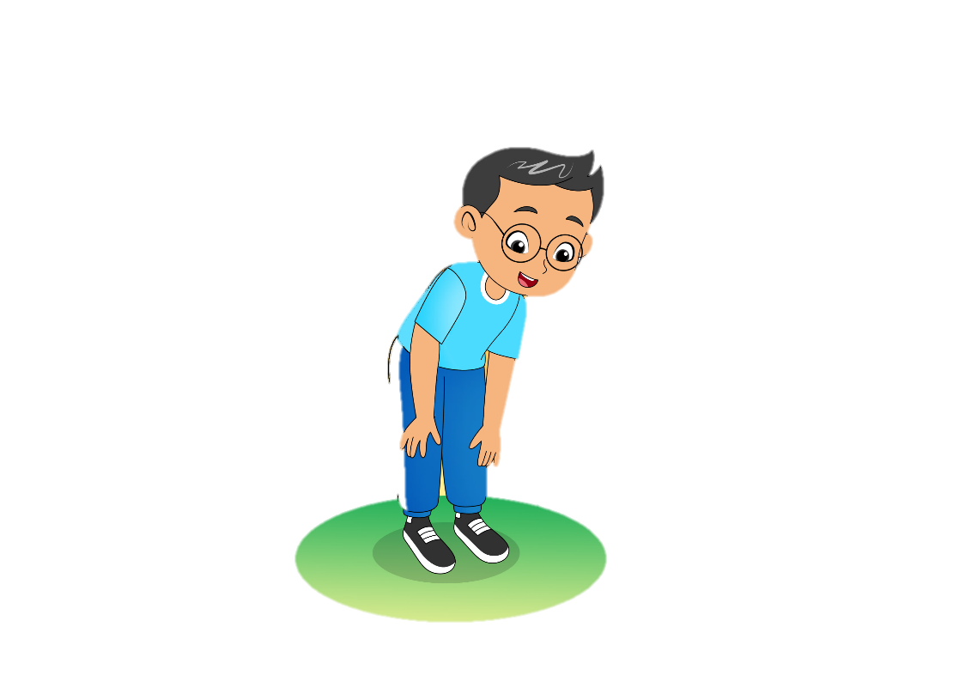
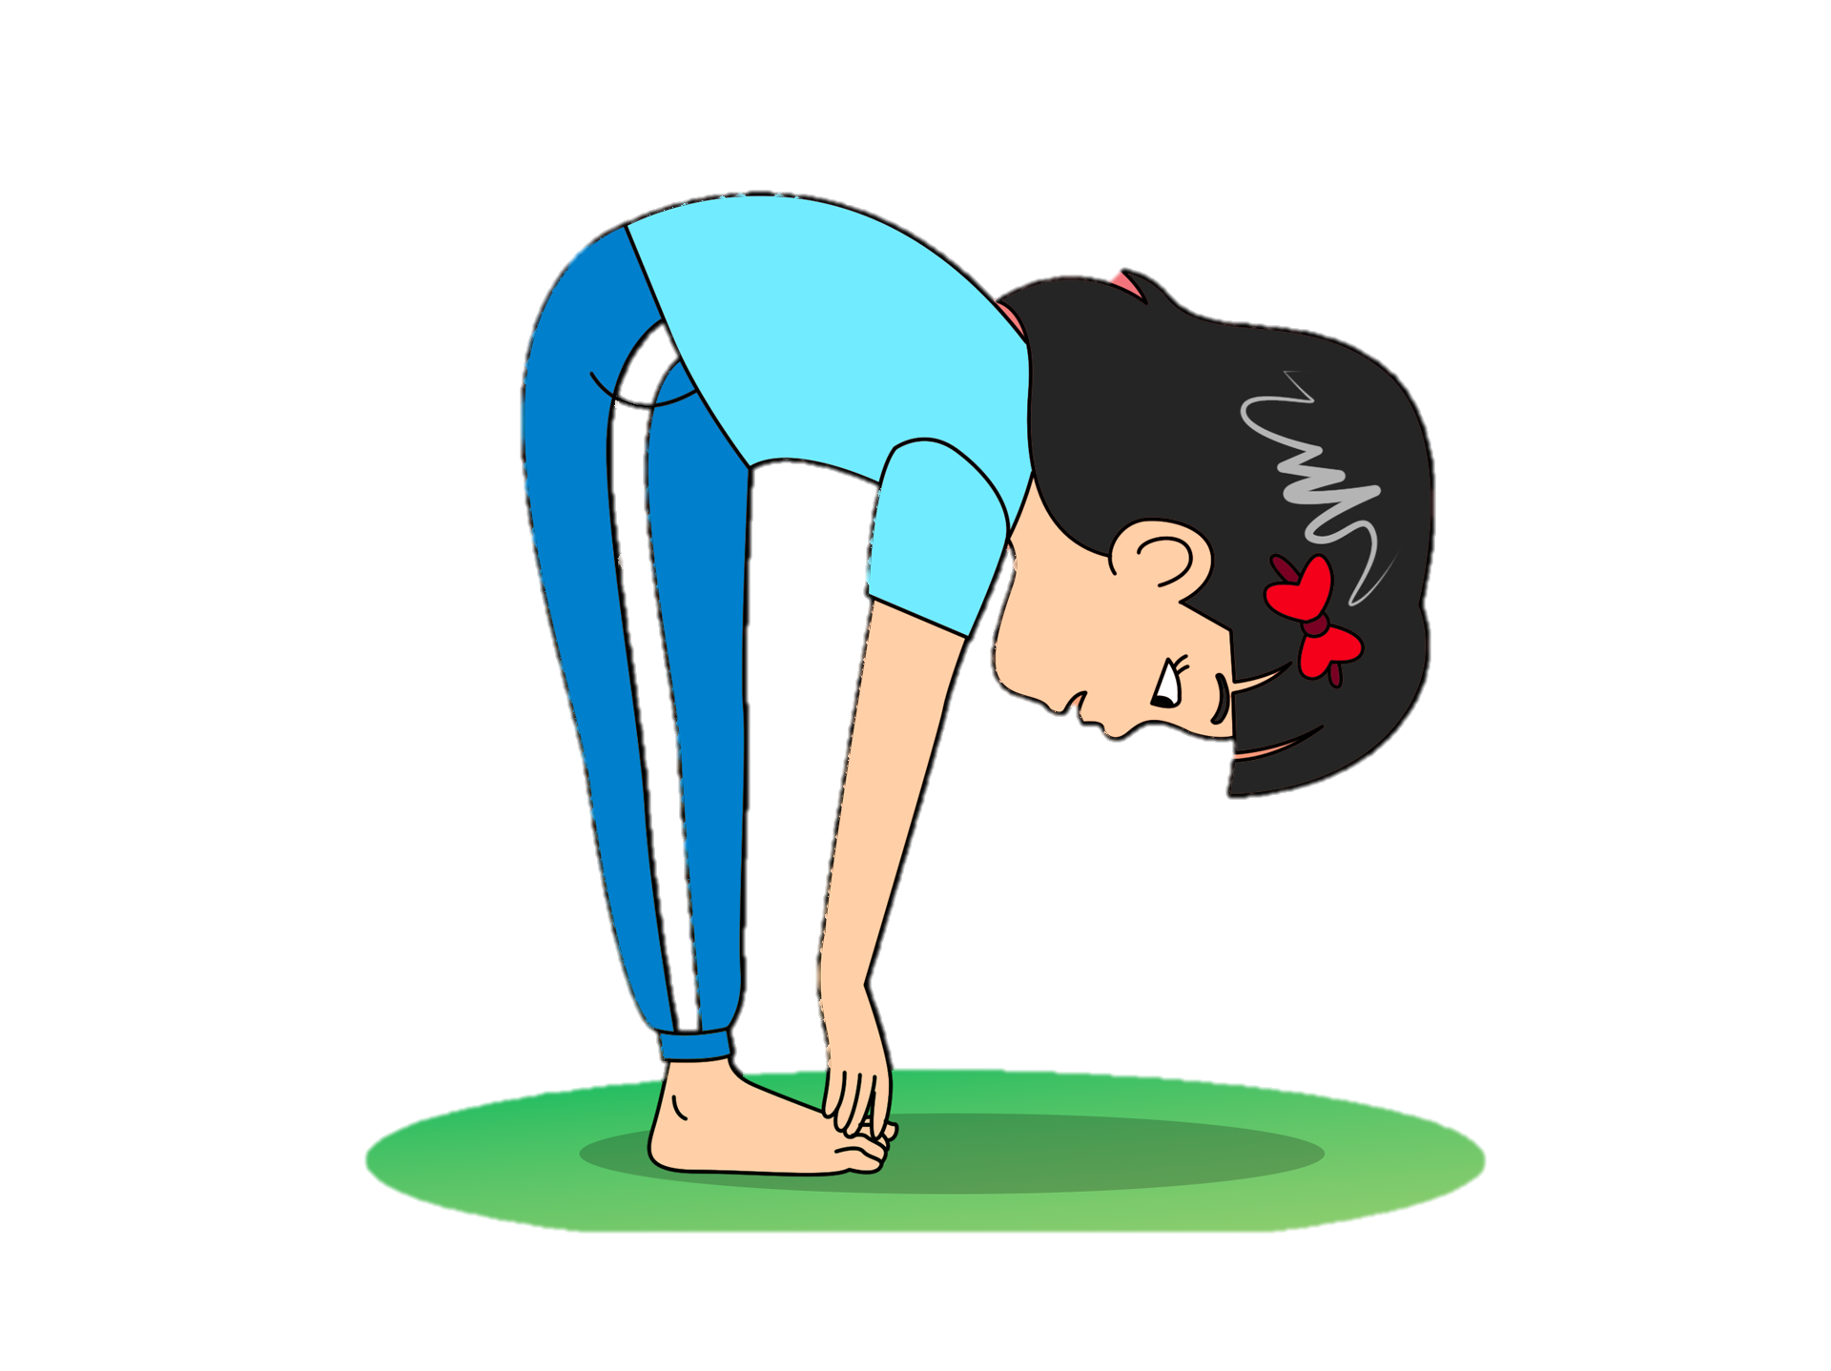
C.
Say a chant.
Reach! High!
Reach high! Touch your head!
Stretch, stretch, stretch
Reach high! Touch your ears!
Stretch, stretch, stretch
Reach high! Touch your knees!
Stretch, stretch, stretch
Reach high! Touch your toes!
Stretch, stretch, stretch

Slide 5
D.
Read aloud.
Sunday
Monday
Tuesday
Wednesday
Thursday
Friday
Saturday

Slide 6
E.
View and sing.
Days of the Week
Sunday, Monday,
Tuesday, Wednesday
Thursday, Friday, Saturday
Sunday, Monday,
Tuesday, Wednesday
Thursday, Friday, Saturday

Slide 7
I.
Listen and talk.
Well, I like math. What about you? Do you like math, too?
What’s your favorite subject, Hana?
Not really. I love social studies and Indonesian.

Slide 8
J.
Ask your friend.
I like science and English.
What’s your favorite subject at school?
Math. Math is my favorite subject.

Slide 9
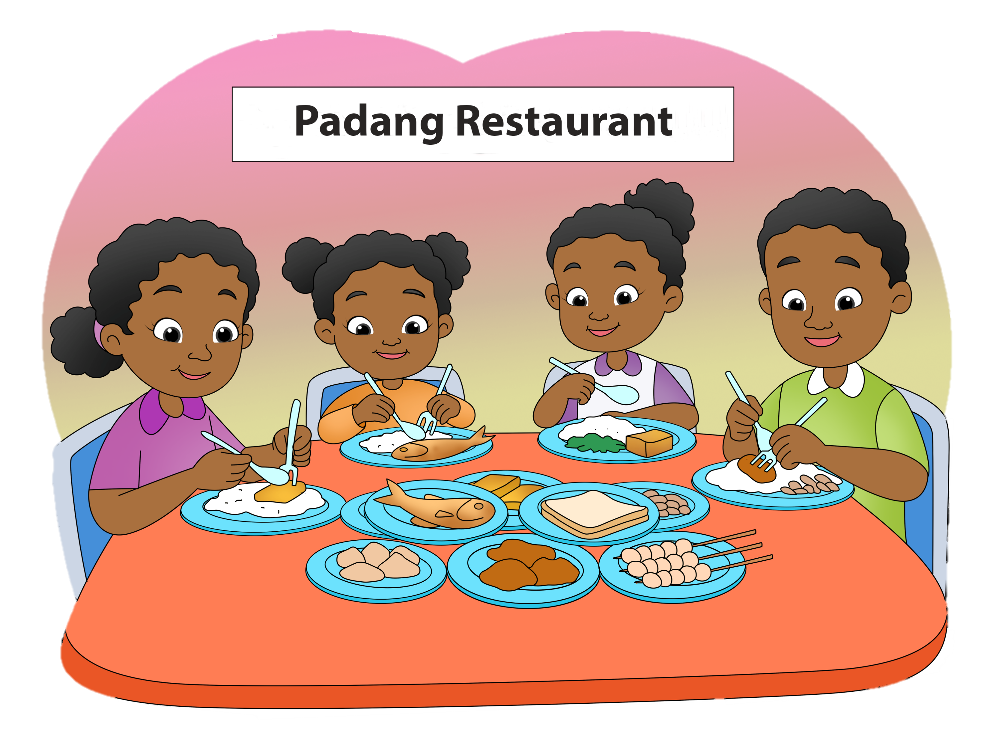
M.
Read for fun.
Sunday, My Favorite Day
Sunday is my favorite day. I spend the day going out with my family. We visit tourist places, like beaches, rivers, or mountains. Sometimes we just travel around the city and eat lunch or dinner together. We often get home when it is dark and we all feel very happy. What a great day!

